Slide 1


Session 2: ODK
Pieter Pypers, Turry Ouma, Kennedy Macharia

Slide 2
Training Outline
Introduction to ODK
Building xlsforms
Setting up ODK Collect
Setting up ona.io account
Authoring advanced xlsforms

Slide 3

Introduction to ODK
Open Data Kit (ODK) is a free and open-source set of tools to help create mobile data collection services.
The tools that are geared towards simple, effective and efficient data collection on mobile devices.

Slide 4
Why ODK?
Powerful forms: Geopoints, Skip logics, calculations, barcodes, Multiple languages, external datasets, audio, video, pictures…
Collect data offline and sync data when connection is available
Data format interoperable with apps like STATA, R, Excel etc.
Open Source: use as is or customize to fit needs
Realtime reports: Prompt data submissions to live dashboards
Proven globally: In use for 13 years in every country with millions of submissions

Slide 5
ODK Components
Build
Creating forms
Collect
Set up ona.io account
Android app
Download forms/collect data
Upload data
Aggregate
Store data (Google AppEngine or webserver)

Slide 6
Build
Creating forms
Forms can be created using: xlsforms, ODK Build, Web-interfaces.
xlsforms
XLSForm is a form standard created to help simplify the authoring of forms in Excel.
Each XLSForm has three mandatory worksheets: survey, choices and settings. These worksheets have mandatory columns that must be present for the form to work and then optional columns.
For more info visit http://xlsform.org/

Slide 7
Build
The Survey Worksheet
The survey worksheet has 3 mandatory columns: type, name, and label.
The type column specifies the type of data you are asking (e.g text, integer, decimal etc. )
The name column specifies the unique variable name. (e.g age)
The label column contains the actual text displayed for the user on the tablet or phone, (e.g. Enter the respondent’s age.) If multiple languages in the questionnaire are desired, label columns that are named accordingly can be used, e.g. label::English, label::Swahili, label::French.
Other columns may also be added as needed such as (hint, required, required_message, relevance, constraint, constraint_message, appearance, calculation

Slide 8
Build
Question types
Question type | Answer Input requested by the type
integer | Integer (i.e., whole number) input.
decimal | Decimal input.
text | Free text response.
select_one [options] | Multiple choice question; only one answer can be selected.
select_multiple [options] | Multiple choice question; multiple answers can be selected.
note | Display a note on the screen, takes no input.
geopoint | Collect a single GPS coordinates.
geotrace | Record a line of two or more GPS coordinates.
date | Date input.
image | Take a picture.
audio | Take an audio recording.
video | Take a video recording.
barcode | Scan a barcode, requires the barcode scanner app to be installed.

Slide 9
Build
Choices Worksheet
list name: Contains the name of the list of response options
name: contains the numeric value for each option in the list
label: contains the text that will appear for each response option
Notes:
Make sure your file is saved in the .xls format and contains no spaces or special characters (‘‐’ and ‘_’ are allowed).
Make sure that your column headers are in lowercase (i.e. “label” or “name”, not “Label” or “Name”)
Make sure that your sheet names are appropriately named (i.e. “survey” not “Sheet 1”, “Survey” or “surveys”)
Make sure that the question names are unique and do not contain spaces or special characters (‘‐’ and ‘_’ are allowed).

Slide 10
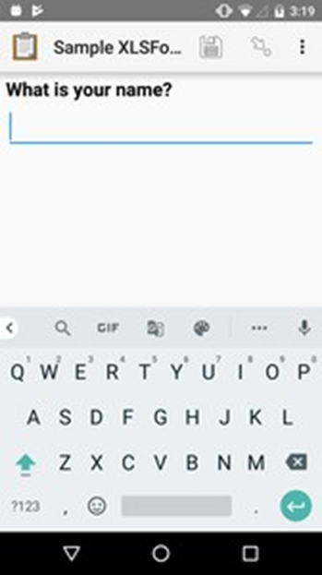
type text
Build
Text widget
The text entry ﬁeld expands as the user types, and line breaks can be included.
A simple text input.
type | name | label
text | name | What is your name?

Slide 11
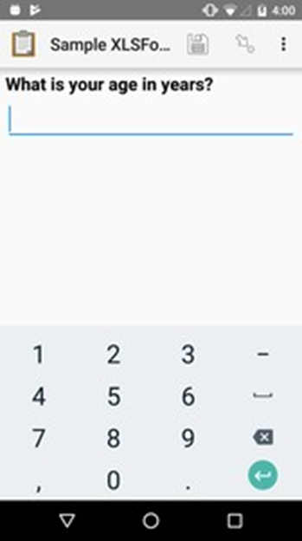
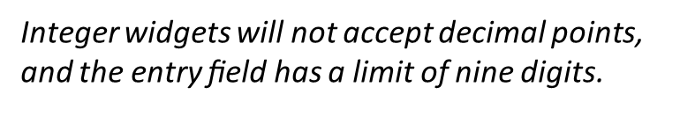
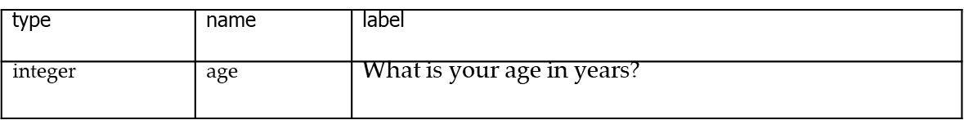
type integer
Build
Number widget
Incase the number has a decimal point, replace ‘integer’ with ‘decimal’

Slide 12
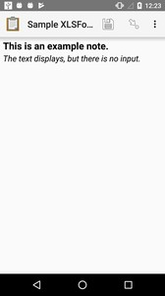
Note widget
Build
Type note
Notes are no‐input text prompts which can give the
enumerator information to read to the respondent or any hints or messages.

Slide 13
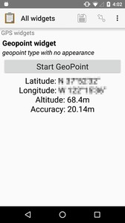
Location widget
Build
Type geopoint
Captures the current location from the device
type | name | label
geopoint | geopoint_widget | Geopoint widget

Slide 14
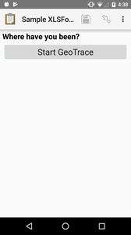
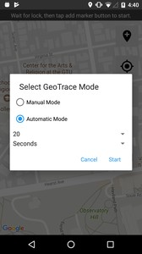
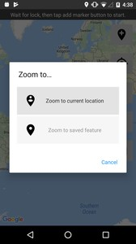
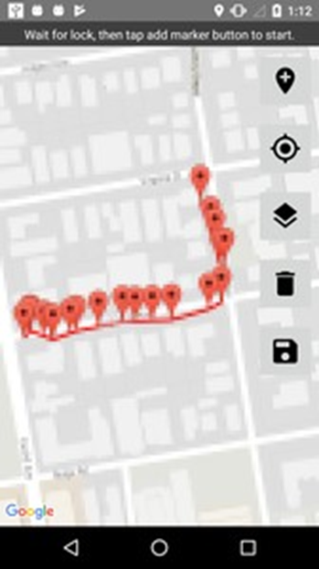
Location widget
Build
Type geotrace
A line or polygon of coordinates tracking actual device movement. The user can specify one of two location-recording modes
Manual Mode The user taps the device to place a marker as desired while moving.
Automatic Mode The app creates a marker on a regular time interval (default: 20 seconds) as the user moves

Slide 15
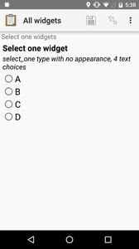
Single select widget
Build
type select_one {list_name}
Select widgets oﬀer the mobile users options to pick from.
The options for a select question are listed on the choices sheet.
type | name | label
select_one opt_abcd | select_one_widg | Select one etwidget
list_name | name | label
opt_abcd | a | A
opt_abcd | b | B
opt_abcd | c | C
opt_abcd | d | D
Notes:
Select widgets oﬀer the participant options to pick from. You can oﬀer the participant a
single choice, or the ability to choose multiple answers.
The options for a select question are listed on a sheet named choices, in your XLSForm ﬁle. The choices sheet has at least three columns:
list_name A set of choices for a single question share a common list_name. The value of list_name is included in the type column on the survey sheet.
name The canonical identiﬁer for a speciﬁc choice. This value is what is stored on the completed form. If you refer to a select response using a variable, the name string is returned.
As with the survey sheet, name must not include spaces.
label The user-facing text displayed for the choice. Select widgets can include images as choices.

Slide 16
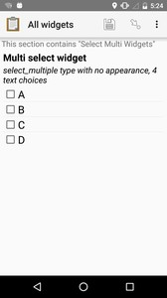
Multiple select widget
Build
type select_multiple {list_name}
Multi select questions support multiple answers
type | name | label
select_multiple opt_abcd | select_multi_widget | Multi select widget
list_name | name | label
opt_abcd | a | A
opt_abcd | b | B
opt_abcd | c | C
opt_abcd | d | D
Notes:
Select widgets oﬀer the participant options to pick from. You can oﬀer the participant a
single choice, or the ability to choose multiple answers.
The options for a select question are listed on a sheet named choices, in your XLSForm ﬁle. The choices sheet has at least three columns:
list_name A set of choices for a single question share a common list_name. The value of list_name is included in the type column on the survey sheet.
name The canonical identiﬁer for a speciﬁc choice. This value is what is stored on the completed form. If you refer to a select response using a variable, the name string is returned.
As with the survey sheet, name must not include spaces.
label The user-facing text displayed for the choice. Select widgets can include images as choices.

Slide 17
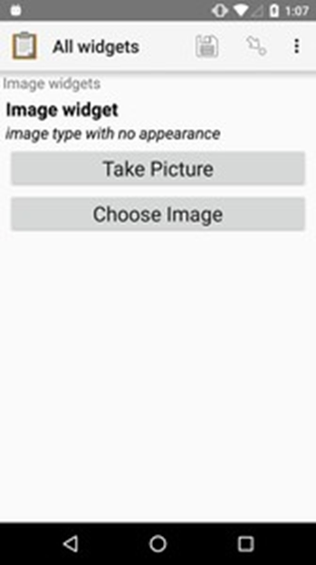
Image widget
Build
Type image
Captures an image from the device. The user can choose to take a new picture with the device camera, or select an image from the device photo gallery
type | name | label
image | image_widget | Image widget

Slide 18
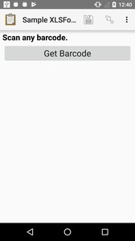
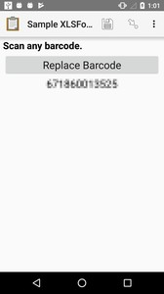
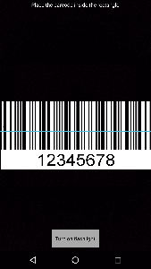
Barcode widget
Build
Type barcode
Scans, decodes, and captures the content of a barcode, using the device camera.
Several barcode formats are supported:
UPC-A
UPC-E
EAN-8
QR Code
type | name | label
barcode | barcode_example | Scan any barcode.

Slide 19
Build
Exercise
1. create your xls template
2. Add the 2 mandatory worksheets.
3. Start planning and deisgning your survey in order to collect the following:
trial location
land clearing method
Between row distance
Number of plants germinated
Weeding date
Name of variety grown
Source of planting material

Slide 20
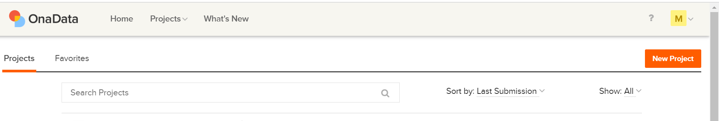
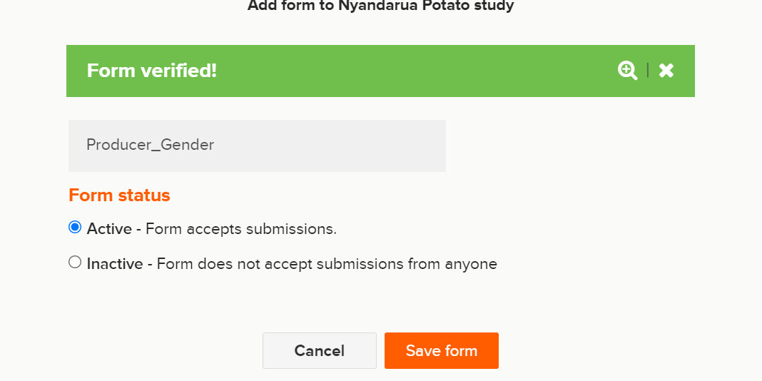
Collect
DuduCamp
*Before you start, ensure you have an ona.io account
Set- up an ona account
www.ona.io
Create an account
Upload xlsform to ona
Go to New Project
Indicate Project Name
Category
Add a form

Slide 21
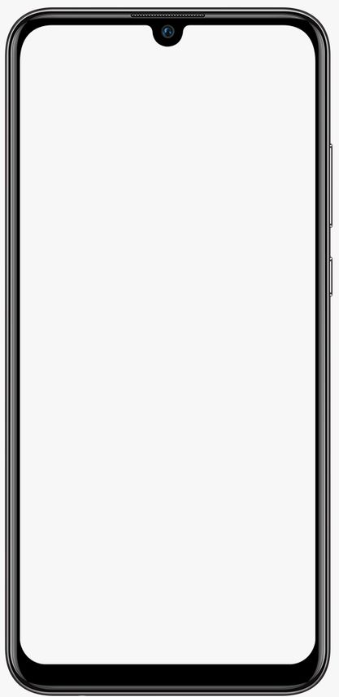
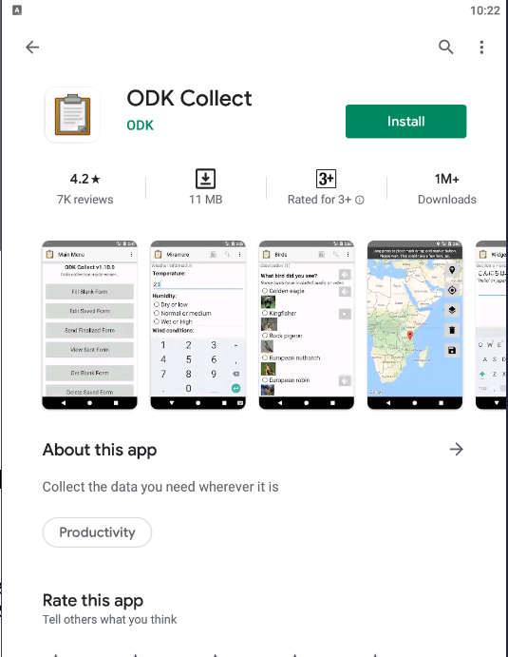
Setting up ODK collect
Install ODK Collect
Download "ODK Collect" from the Google Play Store (recommended)
You can also install remotely using an .apk file

Slide 22
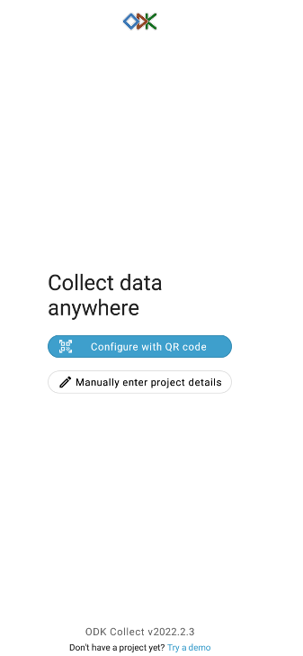
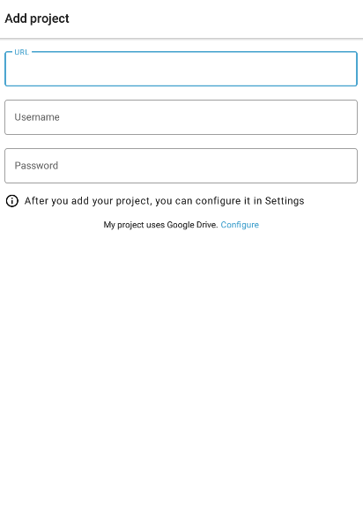
Setting up ODK collect
To configure data synch path;
Manually enter project details
url: https://odk.ona.io/
Username account name
Password Account password

Slide 23
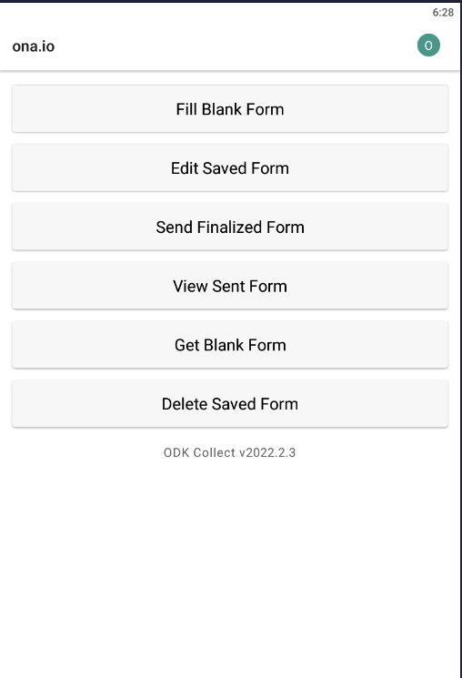
Collect
Main menu
Fill Blank Form Lists available blank forms and lets you select a form to begin ﬁlling out.
Edit Saved Form Lists completed and saved forms and lets you select a form to edit.
Send Finalized Form Lists ﬁnalized but unsent forms and lets you select forms to send to the server.
View Sent Form Lists forms that have been sent, even if they were deleted.
Get Blank form Lists blank forms available on the server and lets you download them.
Delete Saved Form Lists all the Saved and Blank Forms and lets you delete them.

Slide 24
Exercise II
Practise how to;
Get Blank form
Fill Blank Form
Edit Saved Form
Send Finalized Form
View Sent Form
Delete Saved Form

Slide 25
Advanced xlsform Authoring
hint
constraint
constraint_message
appearance
required
required_message
calculation
repeat_count
media:image
media:audio
media:video
choice_filter

Slide 26
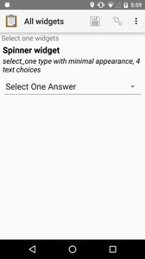
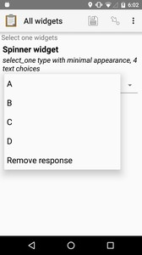
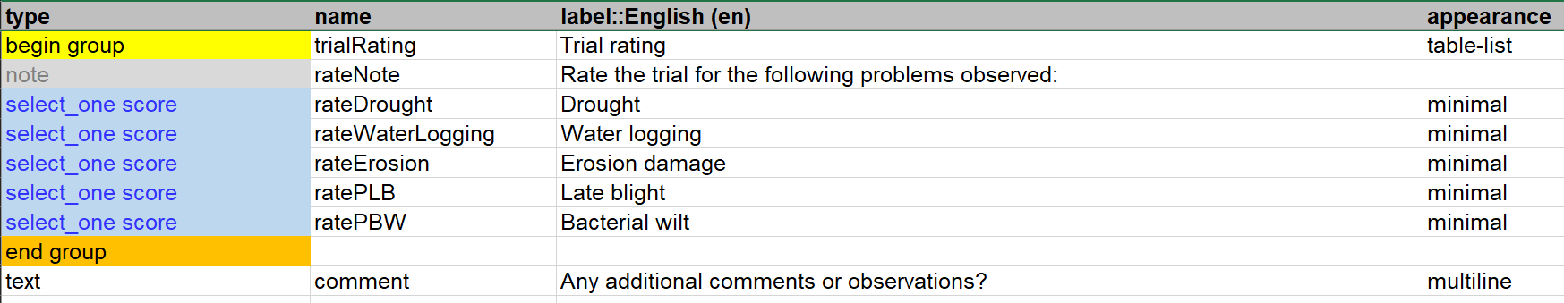
Single select widget with modal menu
Advanced xlsform Authoring
Appearance
Type select_one {list_name}
appearance minimal
Adding the minimal appearance attribute places the choices into a modal overlay menu.
type | name | label | appearance
select_one opt_abcd | spin- ner_widget | Spinner widget | minimal
list_name | name | label
opt_abcd | a | A
opt_abcd | b | B
opt_abcd | c | C
opt_abcd | d | D

Slide 27
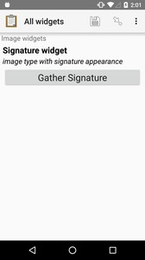
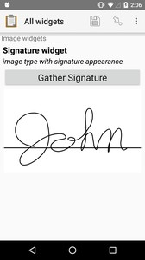
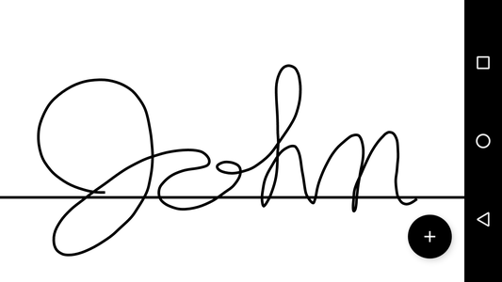
Appearance: Image Signature
Advanced xlsform Authoring
type image
appearance: signature
Collects a signature from the user.

Slide 28
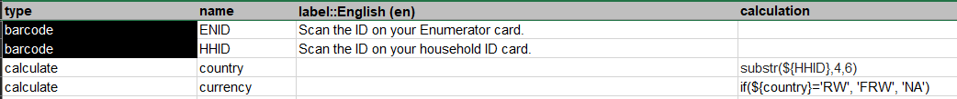
Add a calculation
Advanced xlsform Authoring
Type integer
required: yes
read-only: yes
Calculation: ${var1}+${var2}
If you want to calculate a value and also display it, you create a numeric question, also filling out read-only and calculation

Slide 29
Calculation Math operators
Advanced xlsform Authoring
 | Explanation | Example
+ | addition | ${salary_income} + ${self_employed_income}
- | subtraction | ${income} - ${expenses}
* | multiplication | ${bill} * 1.18
div | division | ${percent_int} div 100
Math operators only work with numbers.

Slide 30
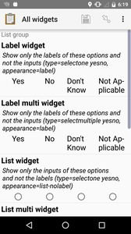
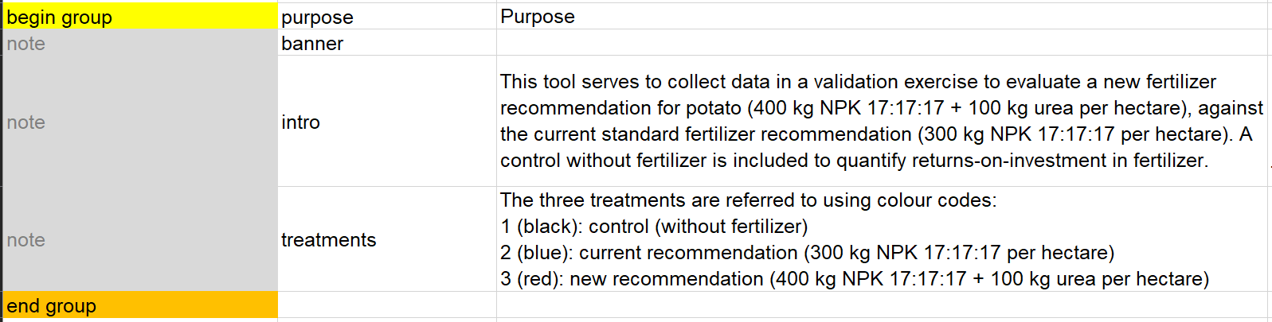
Grouping multiple questions
Advanced xlsform Authoring
type begin_group
appearance ﬁeld-list
The ﬁeld-list appearance attribute, applied to a group of widgets, displays them all on a single screen.
type | name | label | appear- ance
begin_group | gr01 | Section1 | ﬁeld-list
end_group | gr01 | Section1
Notes:
Do not include a question that depends on a previous answer in the same ﬁeld list as the previous question it depends on.
Relevance and calculation values are determined when the screen advances, which does not happen between questions that are grouped on the same page. Therefore, including a question and its dependent together in a ﬁeld list will not work as expected.

Slide 31
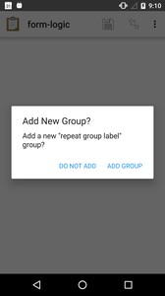
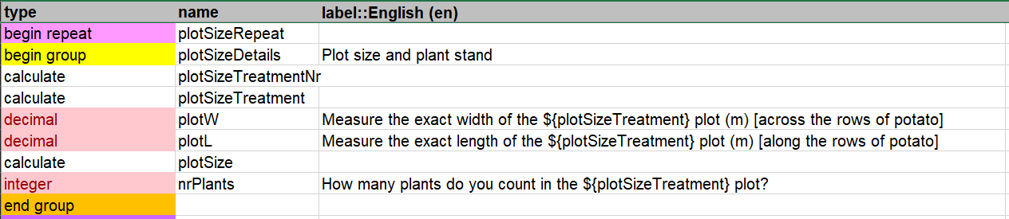
type begin_repeat type end_repeat
Advanced xlsform Authoring
Single question repeat
The user is given the option to add each iteration

Slide 32
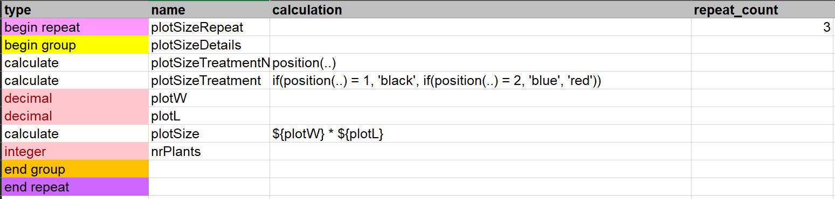
type begin_repeat type end_repeat
Advanced xlsform Authoring
Multi-question repeat
The user is given the option to add each iteration
Use the repeat_count column to deﬁne the number of times a group will repeat.

Slide 33
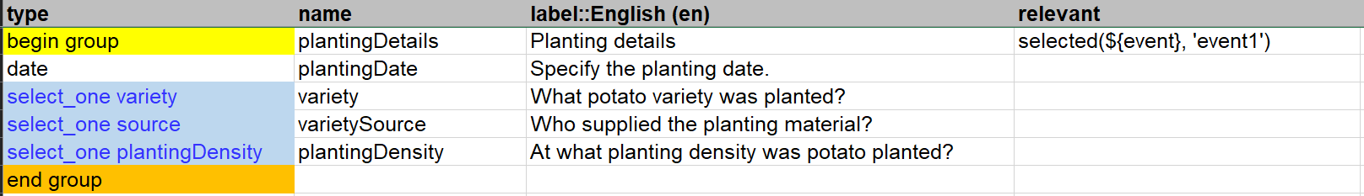
Adding a relevant condition
Advanced xlsform Authoring
Often, comparison operators are used in relevance expressions.
For example:
${age} <= 5 True if age is ﬁve or less.
${has_children} = ’yes’ True if the answer to has_children was yes
selected (${has_children},’yes’) for multi select questions
You may only want certain questions to appear for some users.
For instance, you may only want to ask questions about a user’s land ownership if they indeed have land or about their children if you know they have children.
You can use the relevant column to create skip patterns, only asking questions that are relevant to that respondent.
Relevant conditions can be applied also to groups of questions.

Slide 34
Choice filter
Advanced xlsform Authoring
type | name | label | choice_filter
select_one states | state | state
select_one districts | district | county | state=${state}
select_one sdlocations | sdlocation | sdlocation | state=${state} and district=${district}
survey sheet
To limit the options in a select question based on the answer to a previous question, use a choice_ﬁlter row in the survey sheet, and ﬁlter key columns in the choices sheet.
For example, you might ask the user to select a state ﬁrst, and then only display cities within that state. This is called a cascading select, and can be extended to any depth. This example form shows a three-tiered cascade: state, county, city.
list_name | name | label | state | district
states | 1 | Beirut
states | 2 | Bekaa
districts | 101 | Beirut | 1
districts | 102 | Baalbeck | 2
districts | 103 | Hermel | 2
districts | 104 | Rashaya | 2
districts | 105 | West Beqaa | 2
districts | 106 | Zahle | 2
sdclocations | 201 | Achrafieh | 1 | 101
sdclocations | 202 | Tarek Jadedeh | 1 | 101
sdclocations | 203 | Msaytbi | 1 | 101
sdclocations | 204 | Mazraa | 1 | 101
sdclocations | 205 | Arseal | 2 | 102
sdclocations | 206 | Labweh | 2 | 102
choices sheet

Slide 35
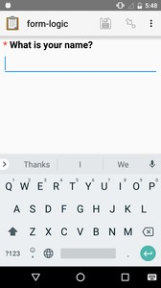
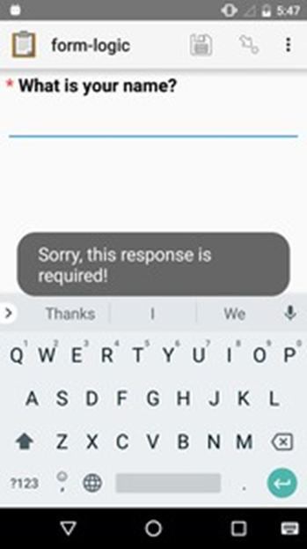
Required Questions
Advanced xlsform Authoring
By default, users are able to skip questions in a form. To make a question required, put yes in the required column.
Required questions are marked with a small asterisk to the left of the question label. You can optionally include a required_message which will be displayed to the user who tries to advance the form without answering the question.
type | name | label | required | required_message
text | name | What is your name? | yes | Please answer the question.

Slide 36
Advanced xlsform Authoring
Constraint
To validate or restrict response values, use the constraint column.
The constraint expression will be evaluated when the user advances to the next screen.
If the expression evaluates to True, the form advances as usual. If False, the form does not advance and the constraint_message is displayed.
The entered value of the response is represented in the expression with a single dot (.).
Constraint expressions often use comparison operators and regular expressions.
For example:
the basic syntax is: “. RULE”
. >= 18 True if response is greater than or equal to 18.
. < 20 and . > 200 True if the response is between 20 and 200.
${VARIABLE}.RULE

Slide 37
Comparison operators in constraint
Advanced xlsform Authoring
Operator | Explanation | Example | Notes
= | equal to | ${enrolled} = 'yes' | Can compare numbers or strings.
!= | not equal to | ${enrolled} != 'yes' | Can compare numbers or strings.
> | greater than | ${age} > 17
>= | greater than or equal to | ${age} >= 18
< | less than | ${age} < 65
<= | less than or equal to | ${age} <= 64
Comparison operators are used to compare values. The result of a comparison is always True or False.
Warning!!!!
The relational operators (>, >=, <, <=) only work with numbers.

Slide 38
Boolean operators in constraints
Advanced xlsform Authoring
 | Explanation | Example
and | True if the expressions before and after are True | ${age} > -1 and ${age} < 120
or | True if either of the expressions before or after are True | ${age} < 19 or ${age} > 64
Boolean operators combine two True or False values into a single True or False value.

Slide 39
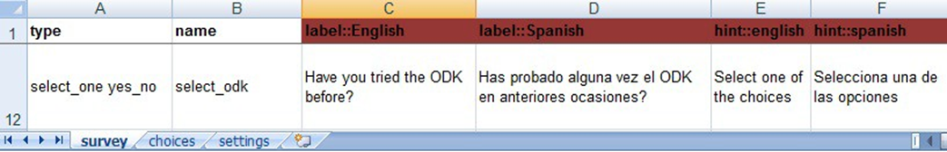

Multiple Language Support
Advanced xlsform Authoring
It is possible to add multiple languages to a survey using in xlsform.
To do this, you have to essentially create a difference label column for each of your languages.
For example a form with the columns label::English and label::French it will allow the surveyors to choose between English and French on ODK Collect, in order to select a different language press the Menu key and the “Change Language” option.
Make sure that your column headers in the “choices” sheet match those in the “survey” sheet (i.e. there will be errors if you columns are “label::English” on the survey and “label” on the choices worksheet)
survey worksheet
choices worksheet

Slide 40
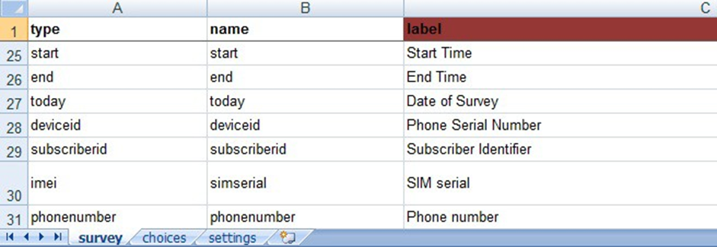
Adding Metadata
Advanced xlsform Authoring
Metadata literally means “data about data”. The user does not enter or see anything. The information is automatically recorded. You can add metadata to the beginning of your XLS form. Below you can find few types:
Add the following rows at the top of the survey (they can be anywhere but it is a best practice to put metadata fields at the beginning of the file):
start (recording the start time of the interview)
end (recording the end time of the interview)
today (recording the date of the interview)
deviceid IMEI (International Mobile Equipment Identity)
Phonenumber Phone number (if available).

Slide 41
Exercise III
More literature: https://docs.getodk.org/ , https://xlsform.org/en/
Practice using different advanced xlsform authoring functions

Slide 42


